Slide 1
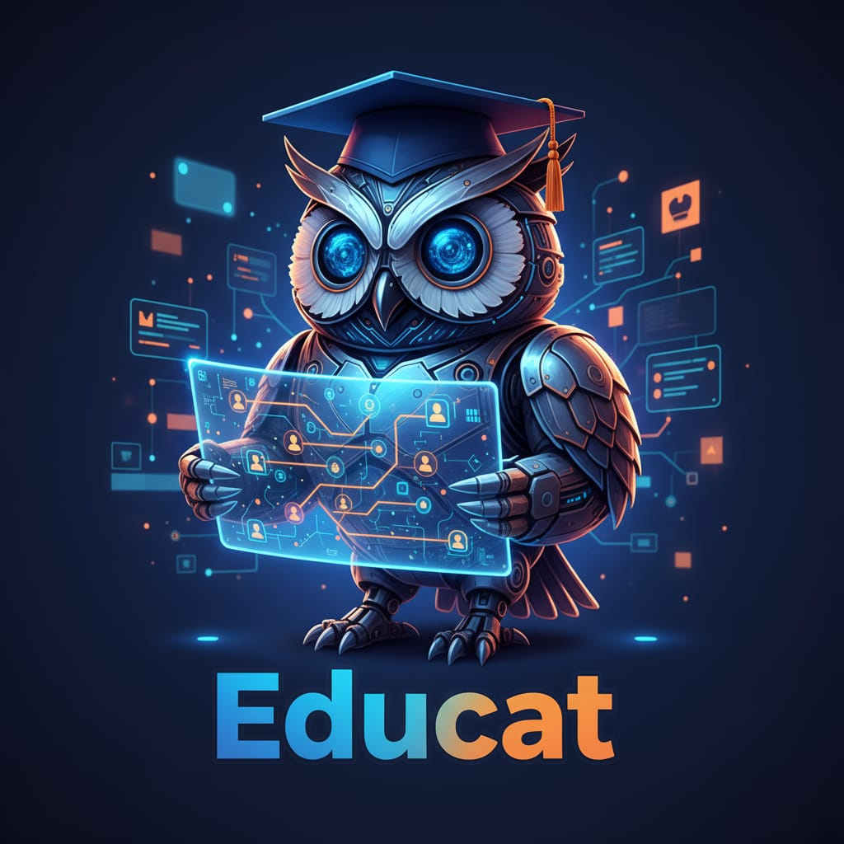


AI Driven Career Architect
Harnessing AI to unlock personalized career journeys and future proof skills!
Team Name: Creative Catalyst
Team Leader Name: Aayush Surwase
Problem Statement-
Today’s job market is rapidly evolving, creating uncertainty for students trying to identify career paths that truly match their unique skills and future opportunities. Existing career guidance is often generic, outdated, and lacks personalized insights driven by real-time market trends. Students need an intelligent, adaptive advisor that not only maps their abilities but also anticipates emerging career demands, empowering them to make confident, future-ready decisions.

Slide 2



EDUCAT PROTOTYPE
Revolutionary AI-driven platform delivering hyper-personalized career guidance by precisely mapping each student’s unique skills and ambitions.
Harnesses real-time, data-rich labor market insights to anticipate future job trends and recommend high-impact career paths.
Empowers students with targeted, actionable strategies for skill enhancement and continuous, adaptive learning.
Crafted with a sleek, intuitive interface to transform career planning into a deeply engaging, user-centric experience.
Built on robust Google Cloud AI infrastructure, ensuring scalable, intelligent, and dynamic career support that evolves with the market.
Positioned to redefine career advisory by bridging individual potential with tomorrow’s workforce demands.

Slide 3

How Educat is Different:
Unlike traditional career platforms, Educat uniquely combines real-time labor market data with personalized AI skill mapping, delivering dynamic and future-focused career guidance.
How Educat Solves the Problem:
By continuously analyzing evolving market trends and individual skills, Educat offers tailored career pathways and skill-building recommendations that empower students to make informed, adaptable decisions.
Unique Selling Proposition (USP):
Educat’s adaptive AI engine proactively anticipates emerging job roles and skills, ensuring students receive timely, actionable insights to stay ahead in a rapidly changing workforce landscape.

Slide 4
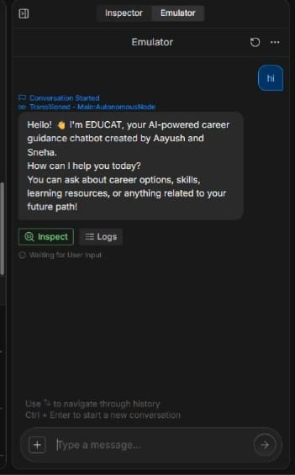
KEY FEATURES OF EDUCAT
Hyper-Personalized Skill Mapping: AI assesses and maps a student's unique skills, interests, and aspirations to build a detailed profile.
Dynamic Career Path Recommendations: Continuously updated career options aligned with real-time labor market trends and future job forecasts.
Skill Gap Analysis & Learning Roadmaps: Identifies skill gaps and suggests tailored learning paths, courses, and certifications to bridge those gaps.
Real-Time Job Market Insights: Integrates live market data to anticipate emerging roles and in-demand skills, keeping students ahead of the curve.

Slide 5
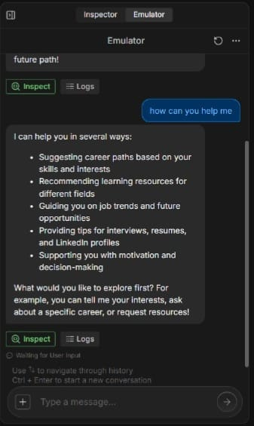
Interactive Career Planning Dashboard: Visualizes career pathways clearly with milestones, progress tracking, and actionable insights.
AI-Powered Virtual Career Coach: Provides 24/7 guidance, answers queries, and offers motivational nudges to keep students engaged.
Adaptive & Continuous Learning Support: Adjusts recommendations based on student progress and evolving market demands for lifelong career growth.
Seamless Google Cloud Integration: Scalable, secure cloud infrastructure supporting data processing, AI model deployment, and user interactions.

Slide 6
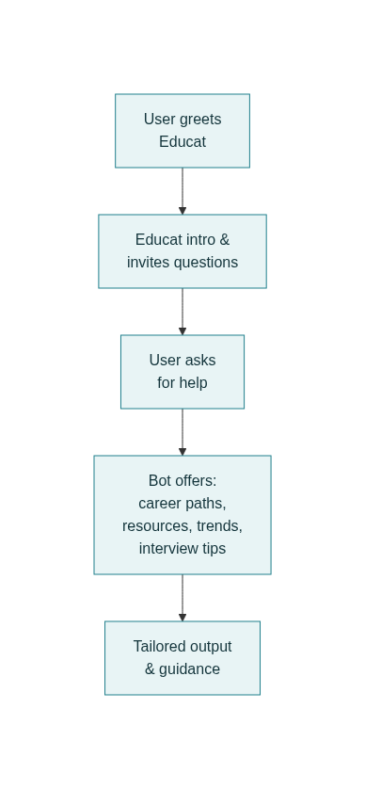
EDUCAT USER JOURNEY OVERVIEW
Users initiate conversation with Educat by greeting and asking career-related queries
Educat introduces itself and guides users to choose career paths, explore skills, and find learning resources
AI-driven insights provide personalized career recommendations, job market trends, and skill-building tips
Continuous engagement with real-time updates ensures students stay motivated and future-ready

Slide 7
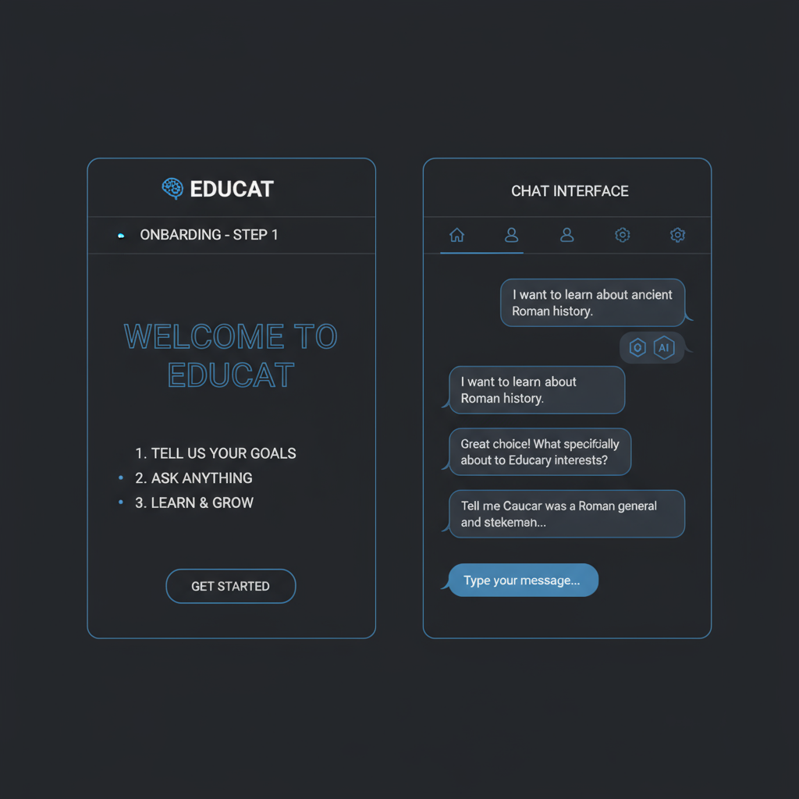
EDUCAT WIREFRAME OVERVIEW
Onboarding screen introduces Educat as a personalized AI career advisor
Conversational chat interface supports natural queries about career paths and guidance
Clean, minimal design facilitates user engagement and easy navigation
AI-driven dynamic responses tailored to individual career and skill development needs

Slide 8
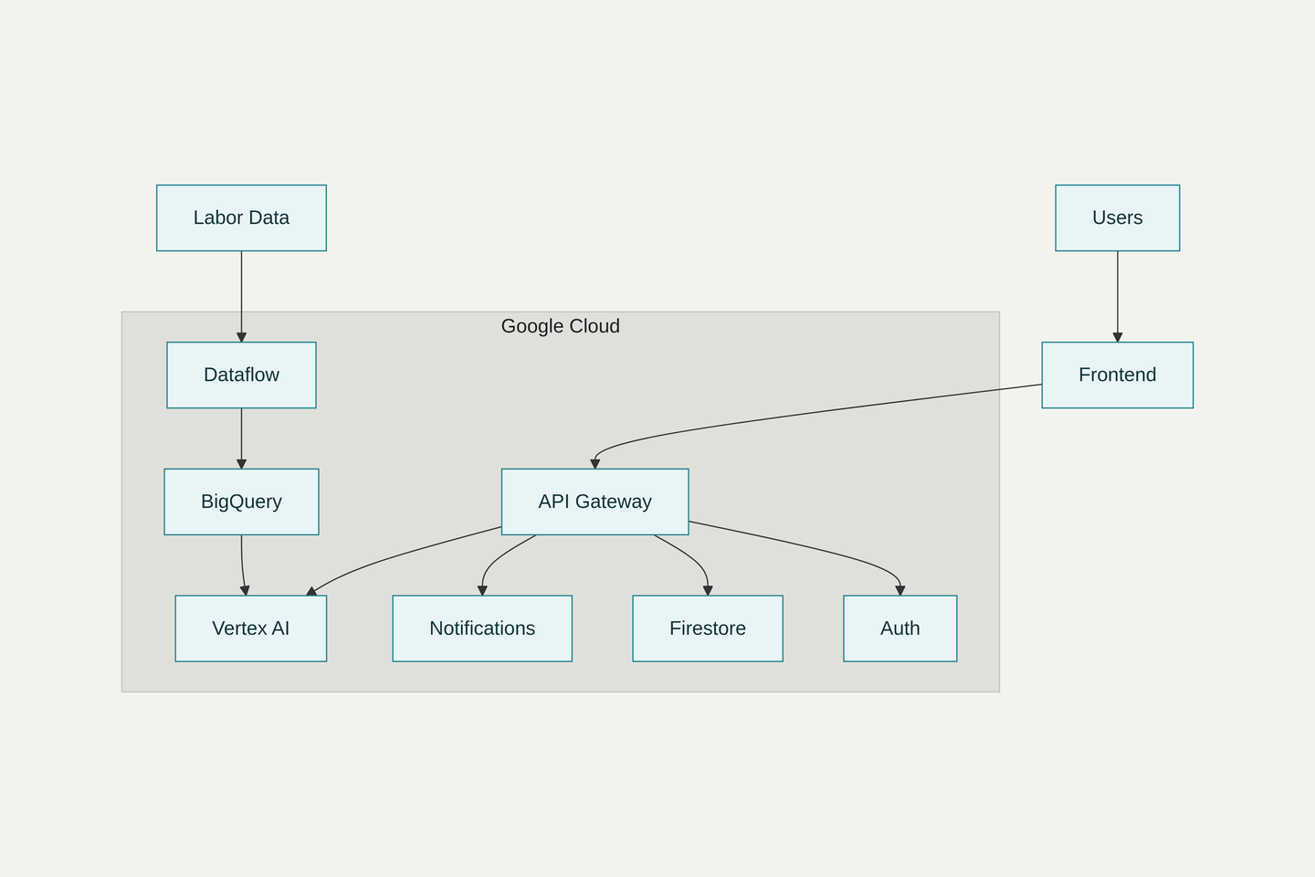
Educat’s frontend is a user-friendly web/mobile chat interface that enables seamless interaction.
An API Gateway securely routes user requests to backend services.
The core AI/ML Engine, powered by Google Cloud Vertex AI, processes skills and delivers personalized career recommendations.
Real-time labor market data is continuously ingested and analyzed through Google Dataflow and BigQuery, ensuring recommendations stay current.
User profiles, conversation histories, and learning progress are securely stored in Firebase Firestore.
Firebase Authentication manages secure user access and data privacy.
The entire system is hosted on Google Cloud Platform, providing scalable, reliable infrastructure for AI services and data management.

Slide 9


Technologies Used in Educat
Google Cloud Vertex AI: For developing, training, and deploying AI/ML models responsible for skill mapping and career path recommendations.
Google BigQuery & Dataflow: For real-time labor market data ingestion, processing, and analytics to keep career insights up-to-date.
Firebase Realtime Database / Firestore: Secure storage of user profiles, conversation history, and personalized recommendations.
Firebase Authentication: To manage user identity, security, and access control.
Google Cloud Functions: Serverless backend functions that orchestrate API calls, data processing, and notification delivery.
Natural Language Processing (NLP) Models: Powered through Vertex AI or integrated APIs to understand and respond to user queries conversationally.
Cloud Monitoring & Logging: For performance tracking, error handling, and system optimization on Google Cloud Platform.

Slide 10
Estimated Implementation Cost
Total estimated cost for developing and deploying Educat: ₹10,000
Covers essential cloud services such as AI/ML model training, data processing, backend infrastructure, and frontend hosting.
Supports prototype development, testing, and initial user engagement with scalability in mind.
Budget-friendly approach leveraging Google Cloud’s free tier and cost-effective solutions.
(This is just a prototype model made using Boatpress-cloud)

Slide 11


Additional Hackathon Requirements Addressed
Innovation: Leveraged Google Cloud Vertex AI and real-time labor market analytics for a dynamic, future-ready career guidance platform.
Scalability: Architected using cloud-native services like Firebase and Dataflow to support growing user bases without compromising performance.
User-Centric Design: Focused on an intuitive AI chatbot interface that enhances user engagement and accessibility.
Social Impact: Aims to empower students with personalized career insights, reducing uncertainty and bridging skill gaps in evolving job markets.
Prototype Completeness: Includes end-to-end skill mapping, personalized recommendations, and motivational support within a working chatbot prototype.
Cost Efficiency: Designed to operate within a modest budget (~₹10,000), making the solution accessible for large-scale adoption.

Slide 12

By- Aayush Surwase
-Sneha Surwase

